Slide 1
Unit 7

Slide 2
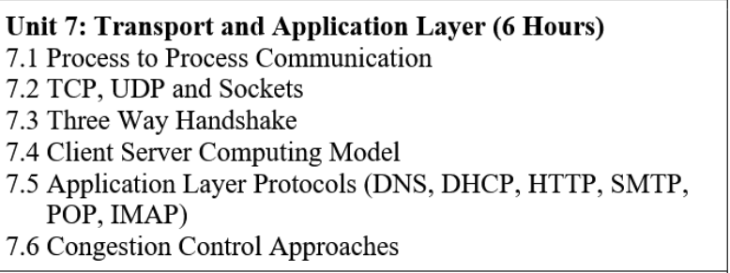

Slide 3
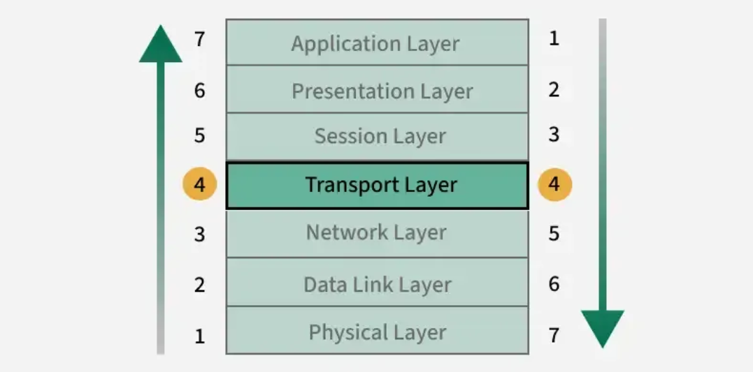
Transport Layer in OSI Model
The Transport Layer is the OSI Layer 4 responsible for providing reliable, efficient, and ordered end-to-end communication between applications on different hosts.
Operates at Layer 4 (Transport Layer) of the OSI model
Enables process-to-process communication using port numbers
Ensures reliability through error control, sequencing, and retransmission
Supports flow control to prevent receiver overload
Uses protocols like TCP, UDP, and SCTP for different application needs

Slide 4
Functions of Transport Layer
The Transport Layer is responsible for end-to-end communication of data packets.
It provides a number of important functions that are responsible for reliable, efficient, and organized data transfer between host systems in a networked environment.
The primary functions of the Transport Layer are:
Provides end-to-end data delivery
Ensures reliable and ordered data transfer
Performs error detection and recovery
Controls data flow to prevent receiver overload
Supports multiplexing and demultiplexing using port numbers

Slide 5
Transport Layer Protocols
Transport Layer Protocol uses different protocol for the better communication between two ends uses of protocol may differ from specifications.
Below mention are some protocols used in Transport Layer
Transmission Control Protocol(TCP)
TCP is connection-oriented Protocol.
TCP is reliable protocol.
As TCP is connection-oriented protocol, so first the connection is established between two ends and then data is transferred and then the connection is terminated after all data being sent.

Slide 6
2. User Datagram Protocol (UDP)
UDP is not reliable protocol
The protocol UDP is connectionless.
When speed and size are more important than security and dependability, this kind of protocol is employed.
The data from the higher layer is supplemented with transport-level addresses, checksum error control, and length information by UDP, an end-to-end transport level protocol.
A user datagram is the packet that the UDP protocol generates.

Slide 7
3-Way Handshake
The 3-Way Handshake ensures both client and server are ready before data transmission begins:
Step 1: SYN (Client -> Server)
Client sends a TCP segment with SYN=1, including its ISN (Initial Sequence Number).
Marks the request to initiate a connection
Step 2: SYN‑ACK (Server -> Client)
Server replies with SYN=1 & ACK=1, containing its own ISN and ACK = client_ISN + 1.
Confirms receipt of client’s SYN and initiates its own sync
Step 3: ACK (Client -> Server)
Client sends an ACK=1 segment with ACK = server_ISN + 1.
Completes synchronization; connection enters ESTABLISHED state

Slide 8
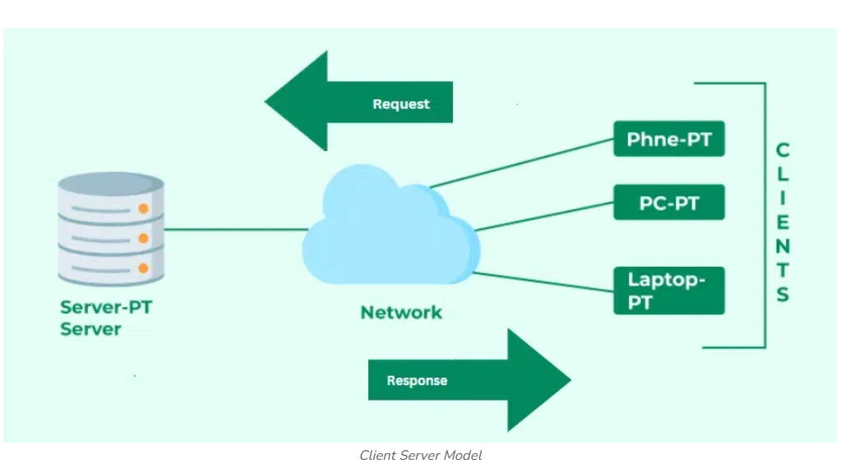
Client-Server Model
The Client-Server Model is a distributed architecture where clients request services and servers provide them.
It underpins many modern systems, including websites, email, and cloud storage platforms.
How Does the Client-Server Model Work?
Client: A client is any device or software that initiates communication by requesting data or services from a server.
Common client applications include:
Web browsers (e.g., Chrome, Firefox)
Email apps (e.g., Gmail, Outlook)
Server: A server is a powerful systems that listens for and responds to client requests by delivering data or performing tasks.
Servers often handle multiple simultaneous client requests. Common server applications include:
Web Servers (e.g., Apache, Nginx)
Email Servers
Database servers

Slide 9
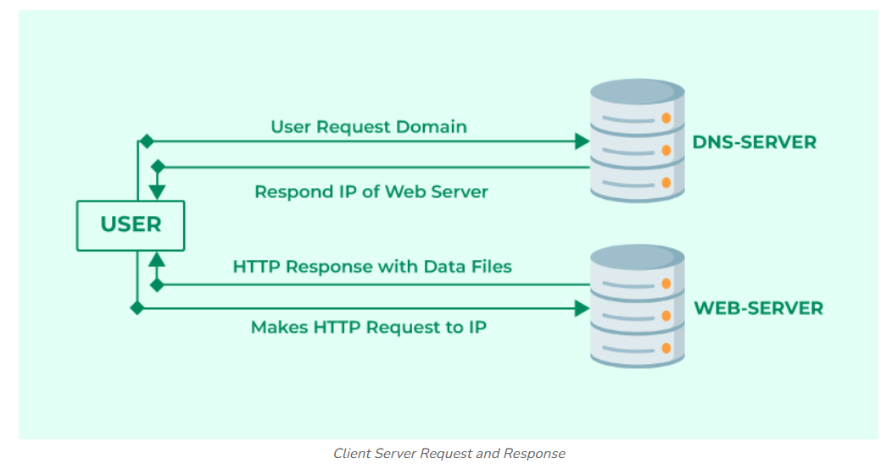
Browser Interacts With the Servers
The process of interacting with servers through a browser involves several steps:
1. User Enters the URL (Uniform Resource Locator): The user types a website address (e.g., www.example.com) into the browser's address bar.
2. DNS (Domain Name System) Lookup: The browser contacts a DNS server to convert the domain into an IP address.
3. Establishing a Connection: The browser sends an HTTP/HTTPS request to the server using the resolved IP address.
4. Server Responds: The server sends back website files (HTML, CSS, JavaScript, images).
5. Browser Renders the Webpage
DOM interpreter: Processes HTML to structure the page.
CSS interpreter: Applies styles
JavaScript Engine: Adds interactivity (using JIT compilation for performance).

Slide 10
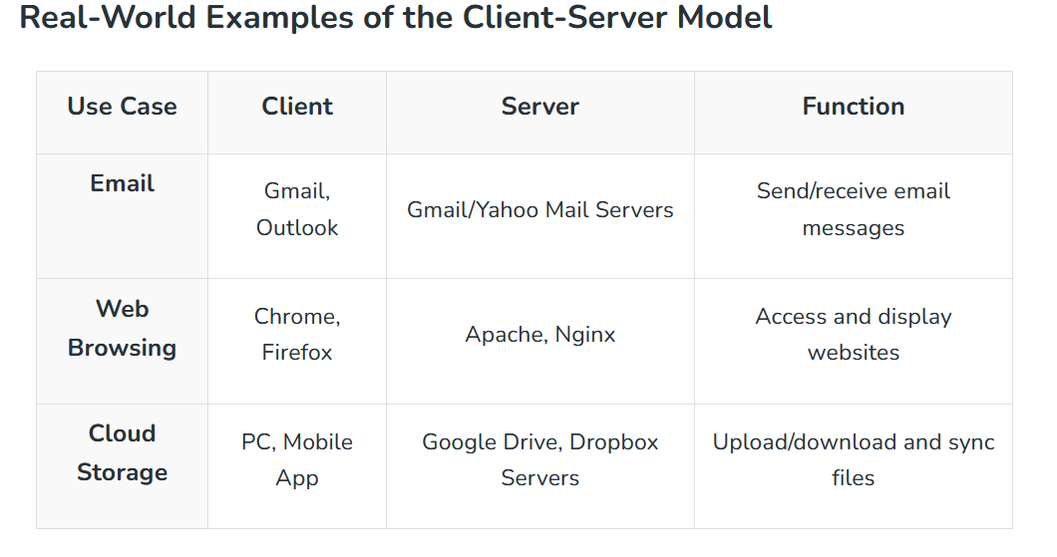

Slide 11
Advantages of the Client-Server Model
Centralized Data Management: Easy to maintain and back up data.
Cost Efficiency: Clients require less processing power.
Scalability: Servers and clients can scale independently.
Security: Centralized security policies and authentication.
Data Recovery: Easier backup and restore from a single source.

Slide 12
Disadvantages of Client-Server Model
Client Vulnerability: Risk of malware if servers distribute unsafe files.
Server as a Target: Susceptible to DDoS (Denial of Service) attacks.
Data Spoofing: Unprotected data can be tampered with in transit.
MITM Attacks: Unsecured connections can be intercepted by attackers.

Slide 13
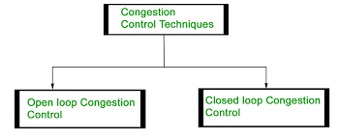

Slide 14
